Slide 1
CORE JAVA DAY9
NEEHARIKA

Slide 2
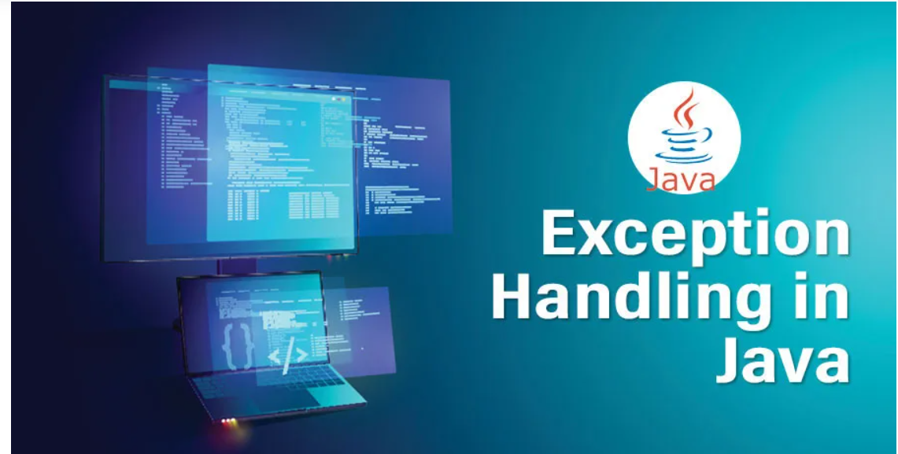

Slide 3
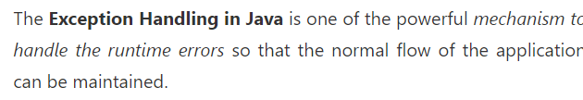
Exception Handling in Java

Slide 4

What is Exception in Java?

Slide 5
What is Exception Handling?

Slide 6
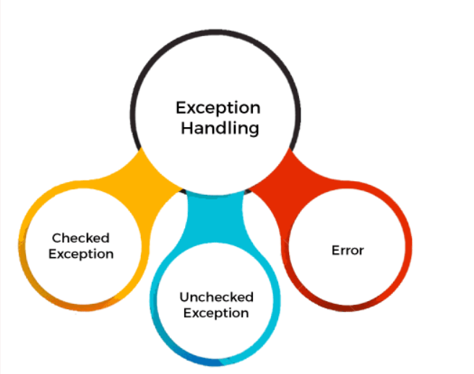
Types of Java Exceptions

Slide 7
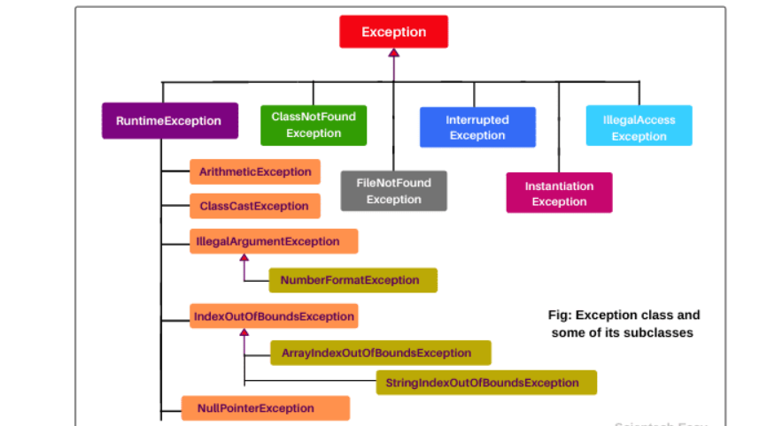

Slide 8
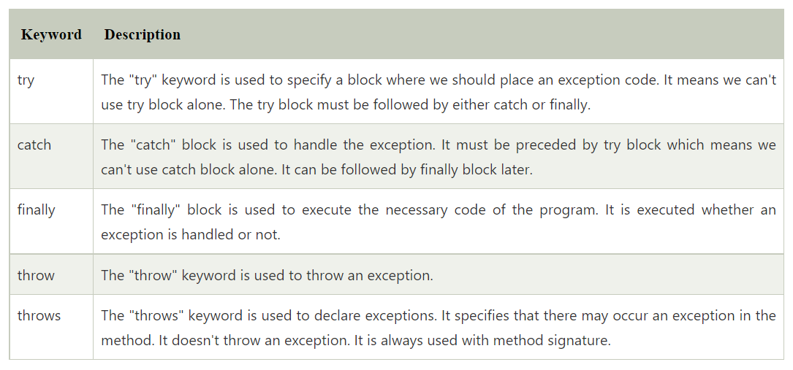
Java Exception Keywords

Slide 9
Java try block
Java try block is used to enclose the code that might throw an exception. It must be used within the method.

Slide 10
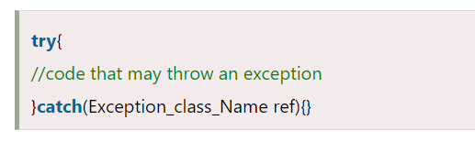
Syntax of Java try-catch

Slide 11
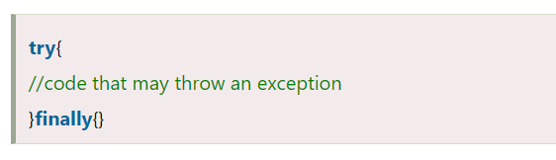
Syntax of try-finally block

Slide 12
Java catch block
Java catch block is used to handle the Exception by declaring the type of exception within the parameter

Slide 13
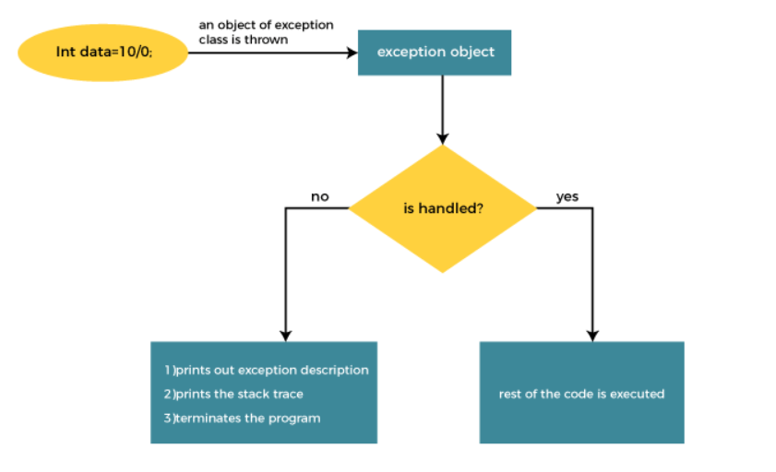
Internal Working of Java try-catch block

Slide 14
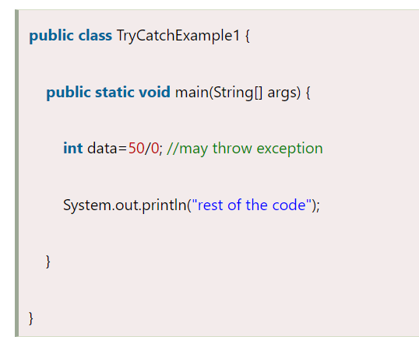
TryCatchExample

Slide 15
Checked and Unchecked Exceptions

Slide 16
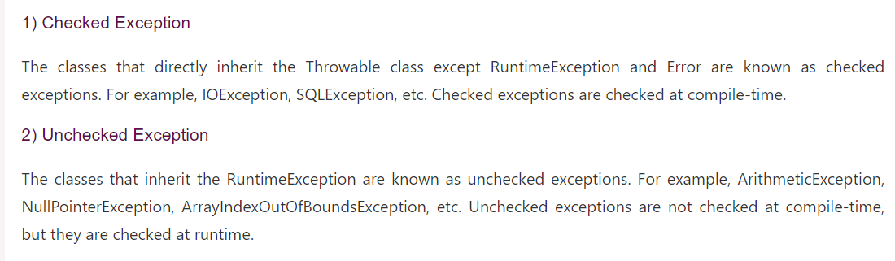

Slide 17
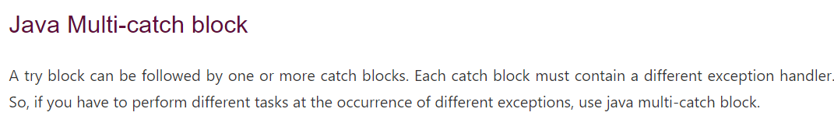

Slide 18
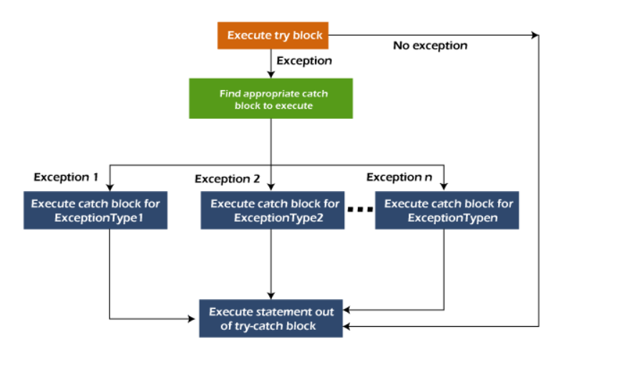
Flowchart of Multi-catch Block

Slide 19
Java Nested try block
In Java, using a try block inside another try block is permitted. It is called as nested try block. Every statement that we enter a statement in try block, context of that exception is pushed onto the stack.

Slide 20
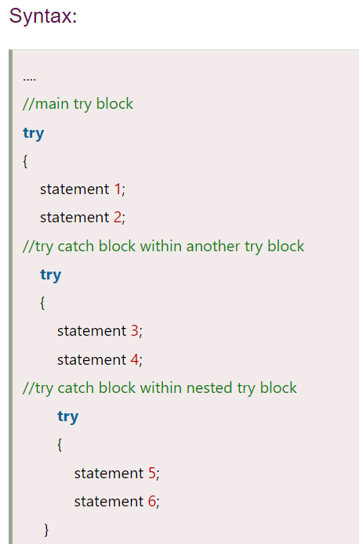

Slide 21
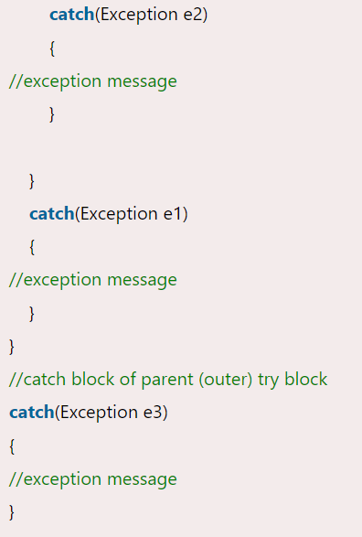

Slide 22
Java throws keyword
The Java throws keyword is used to declare an exception. It gives an information to the programmer that there may occur an exception.

Slide 23
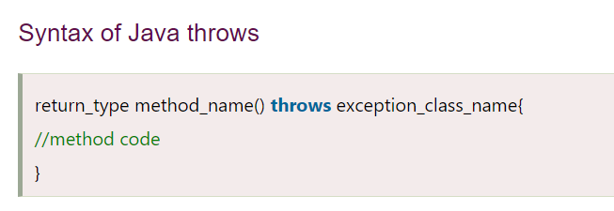

Slide 24
Exception Handling with Method Overriding in Java

Slide 25
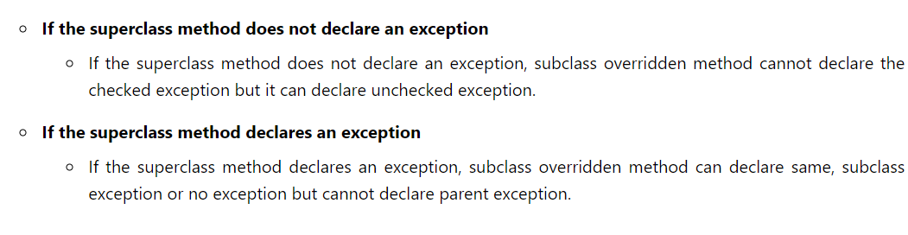

Slide 26
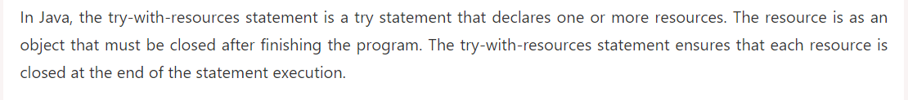
Try with Resources

Slide 27
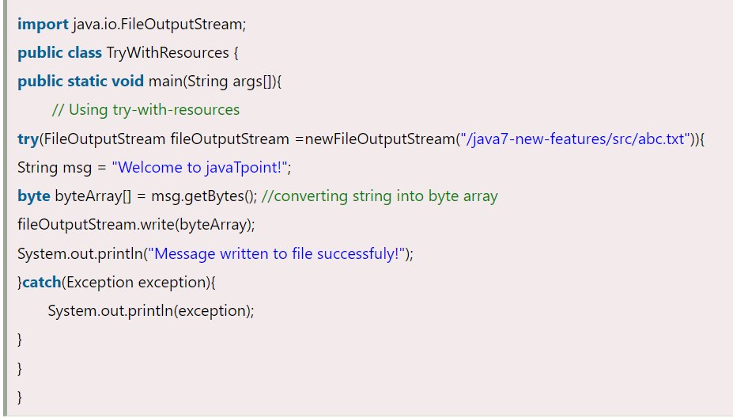
Try-with-resources Example

Slide 28
Java finally block
Java finally block is a block used to execute important code such as closing the connection, etc.

Slide 29
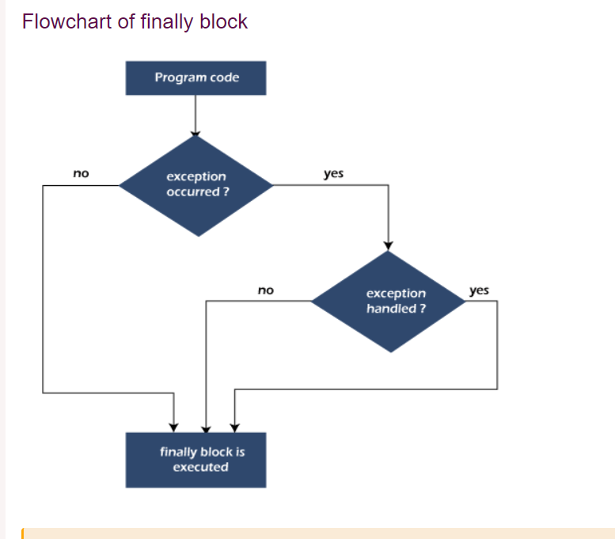

Slide 30
Why use Java finally block?

Slide 31
Why Use Java finally block ?
1: When an exception does not occur
2: When an exception occur but not handled by the catch block
3: When an exception occurs and is handled by the catch block
1

Slide 32
Custom Exceptions
In Java, we can create our own exceptions that are derived classes of the Exception class. Creating our own Exception is known as custom exception or user-defined exception. Basically, Java custom exceptions are used to customize the exception according to user need.

Slide 33
Why use custom exceptions?
To catch and provide specific treatment to a subset of existing Java exceptions.
Business logic exceptions: These are the exceptions related to business logic and workflow. It is useful for the application users or the developers to understand the exact problem.

Slide 34
Java File Handling

Slide 35
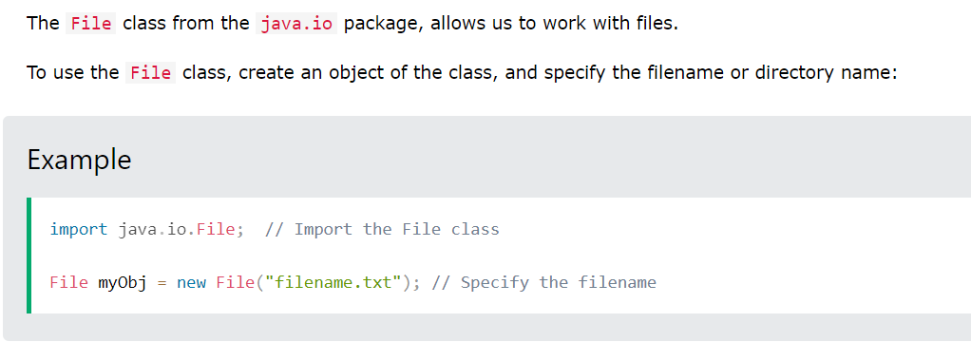

Slide 36
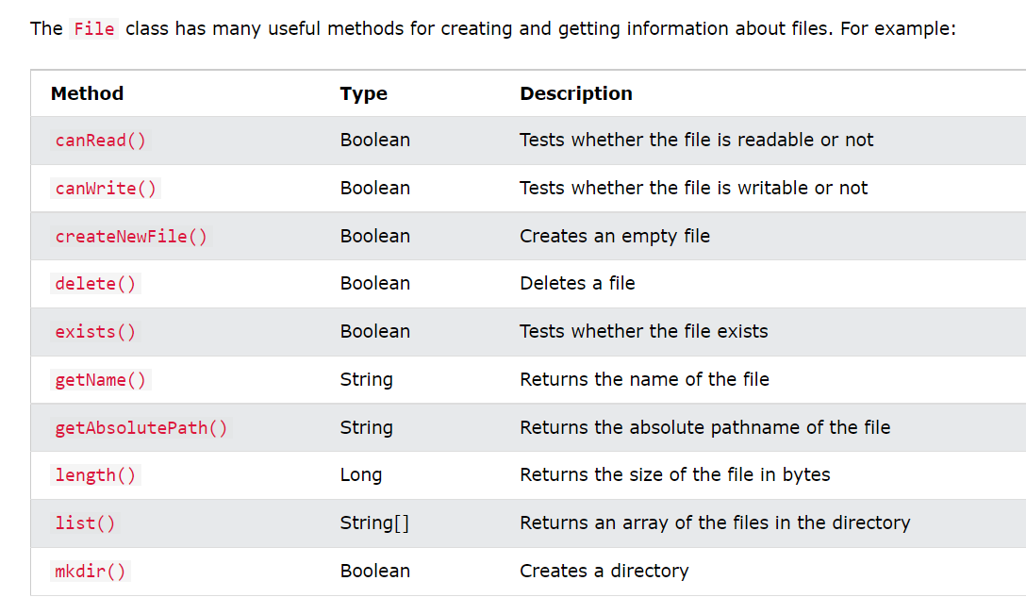

Slide 37
Byte and character Streams

Slide 38
ByteStream Classes in Java
ByteStream classes are used to read bytes from the input stream and write bytes to the output stream.
The ByteStream classes are divided into two types of classes, i.e., InputStream and OutputStream. These classes are abstract and the super classes of all the Input/Output stream classes.

Slide 39
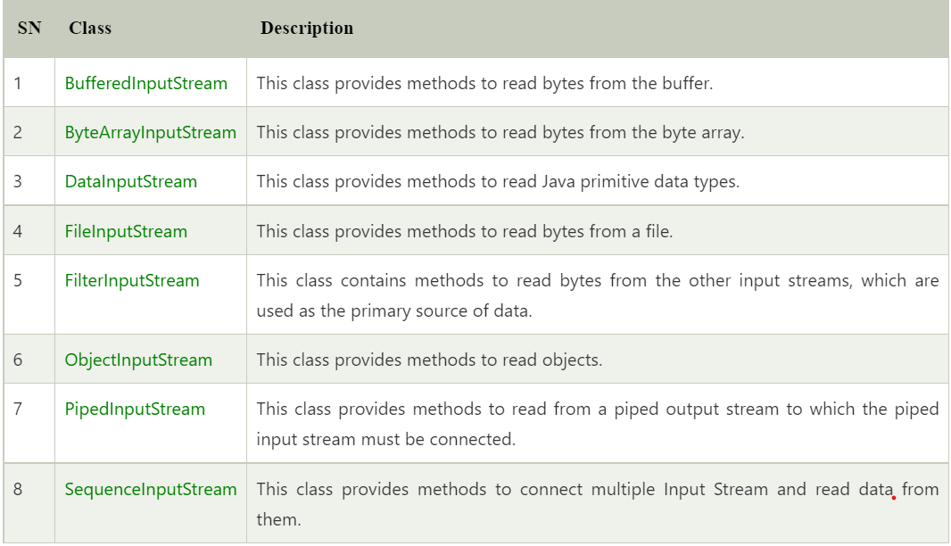
InputStream Class

Slide 40
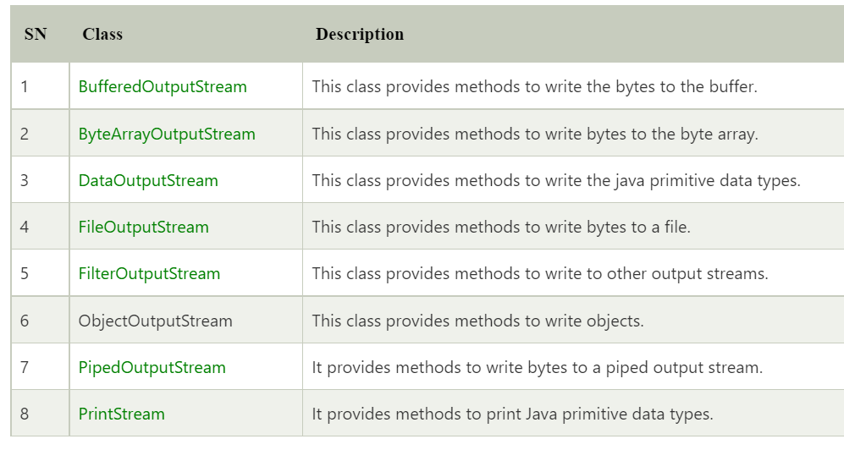
OutputStream Class

Slide 41
CharacterStream Classes in Java
The Characterstream Classes Are Mainly Used To Read Characters From The Source And Write Them To The Destination. For This Purpose, The Characterstream Classes Are Divided Into Two Types Of Classes, I.E., Reader Class And Writer Class.

Slide 42
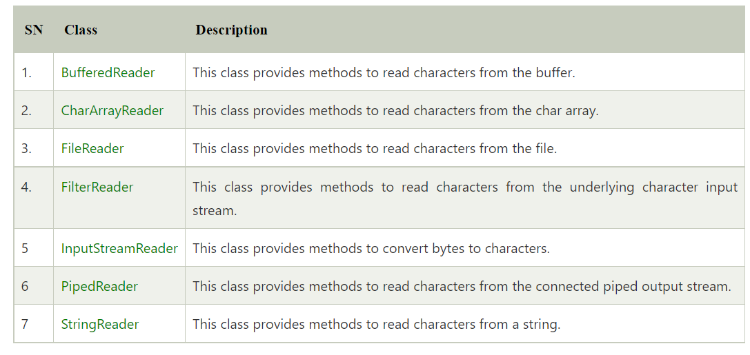
Reader Class

Slide 43
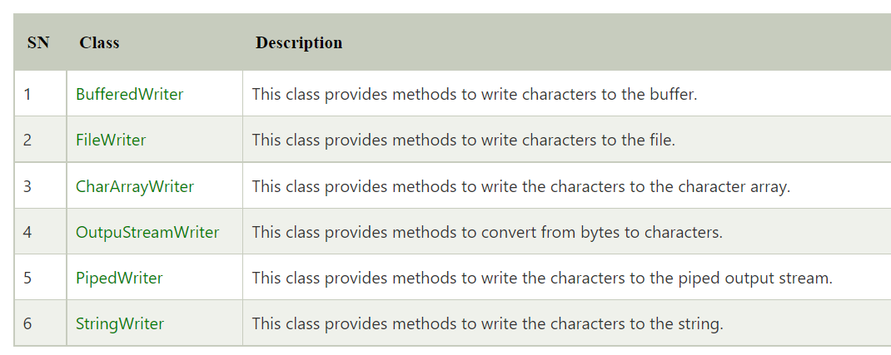
Writer Class

Slide 44
Java I/O class hierarchy

Slide 45
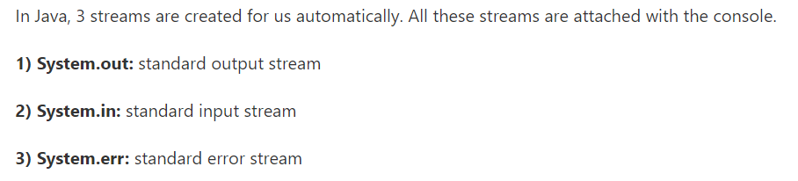
Java I/O (Input and Output) is used to process the input and produce the output.
Java uses the concept of a stream to make I/O operation fast. The java.io package contains all the classes required for input and output operations.

Slide 46
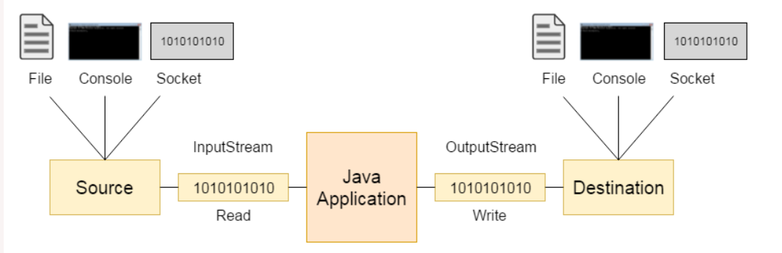
OutputStream vs InputStream

Slide 47
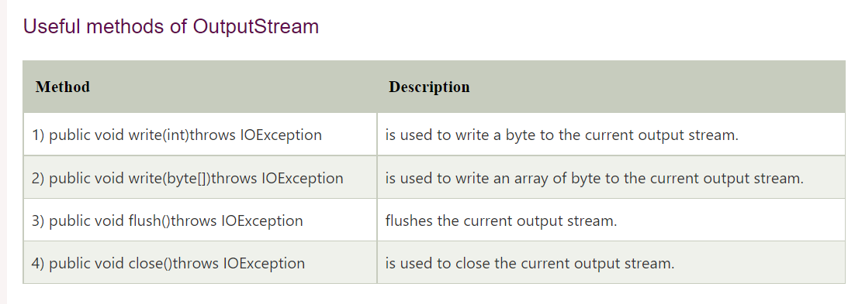

Slide 48
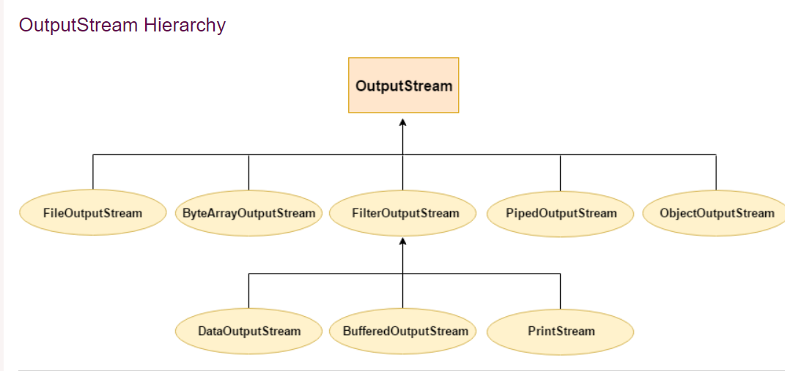

Slide 49
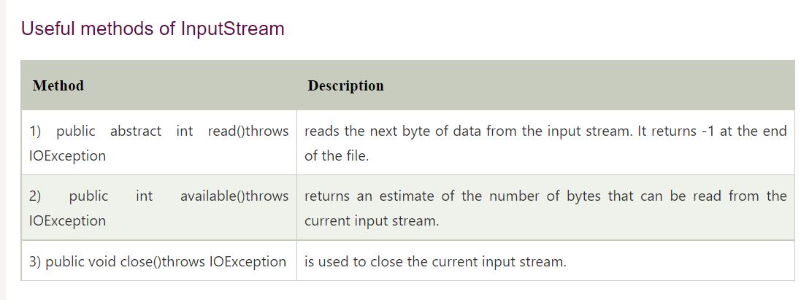

Slide 50
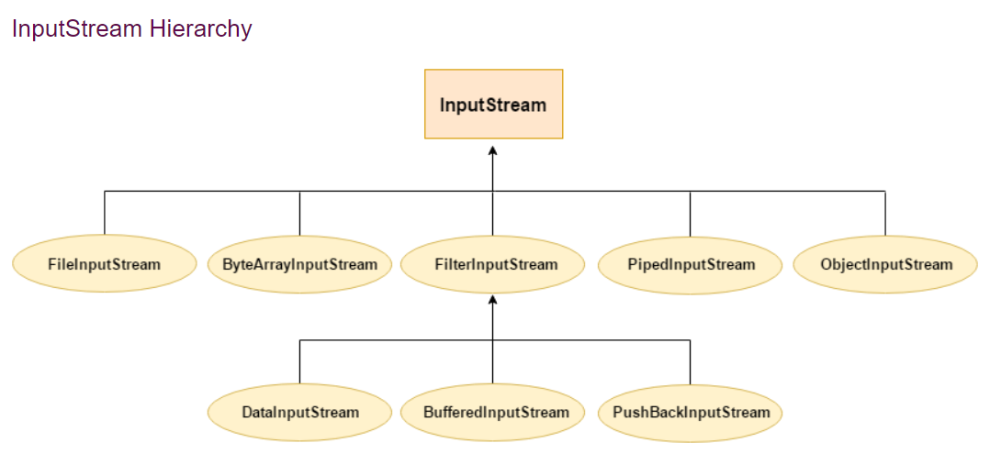

Slide 51
Java FileWriter Class

Slide 52
Java File Writer class is used to write character-oriented data to a file
. It is character-oriented class which is used for file handling in java
.

Slide 53
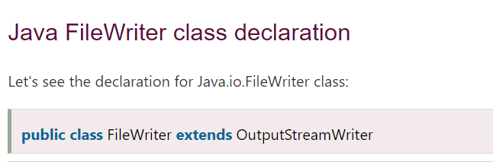

Slide 54
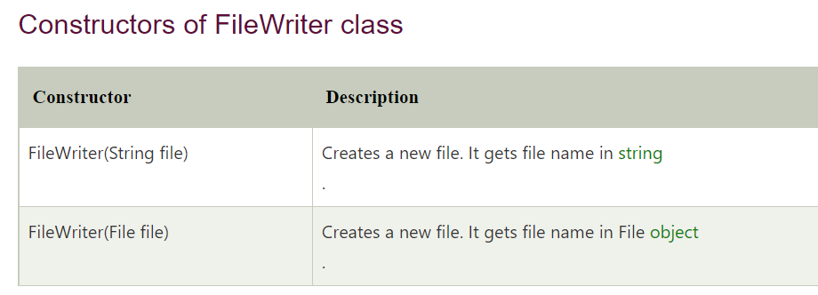

Slide 55
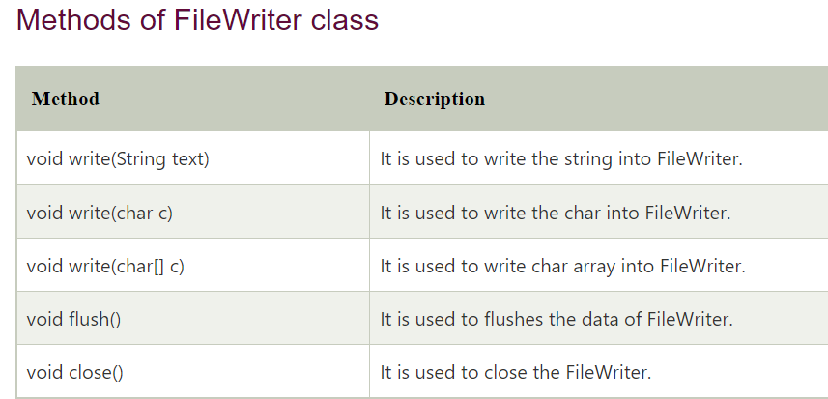

Slide 56
Java FileReader Class

Slide 57
Java FileReader class is used to read data from the file. It returns data in byte format like FileInputStream class.
It is character-oriented class which is used for file handling in java.

Slide 58
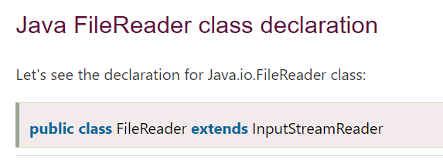

Slide 59
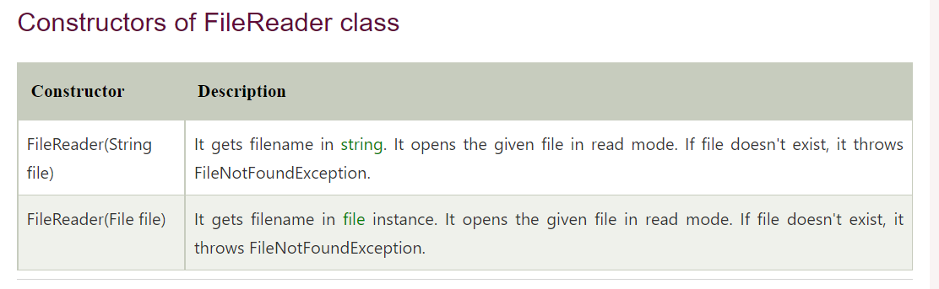

Slide 60
